Slide 1

TRAVCLAN ASSIGNMENT BUSINESS ANALYST
HARSHIT GARG 12111017
708227187 hgarg4145@gmail.com

Slide 2
ASSIGNMENT PROBLEM STATEMENT
GIVEN : CSV DATA FILE (DATASET-2)
1. Identify 3 short-term or long-term data observations. 2. Analyze the possible causes behind these observations. 3. Suggest strategies to improve sales and profitability.
Tools Used :
Jupyter Notebook
Python
Python Libraries : Pandas , Matplotlib

Slide 3
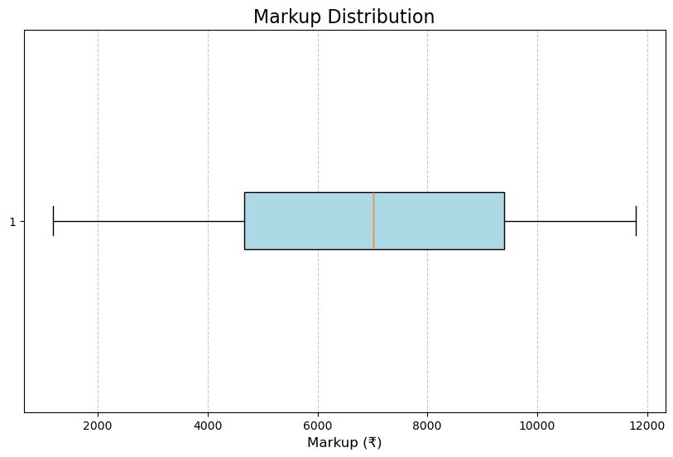
High Variance in markup
Significance difference in markup values across transactions. The markup ranges from ₹1,181 to ₹11,800, with an average of ₹6,963.
The standard deviation is ₹2,860, indicating high variance in pricing.
Possible Causes
Dynamic Pricing Strategies influenced by demand, competition or supplier pricing .
Inconsistent pricing rules for different channels or buyers segments .
Higher markups for peak season or last minute bookings .
Special promotional campaigns leading to reduced or negative markups .

Slide 4
Suggestion
Optimize Pricing: Use dynamic pricing algorithms to reduce markup variance while maintaining profitability . Monitor market trends to adjust markups competitively, focusing on high-margin routes.
Example: For a flight from New York (JFK) to London (LHR), if demand is consistently high, increase markup by 15-20%.Conversely, for low-demand routes, keep markups competitive to attract more bookings.
Dynamic Pricing Strategies:
Use historical data, competitor pricing, and demand forecasting to adjust markups dynamically.
For example:
High-demand seasons (e.g., summer vacations): Increase markups slightly due to increased willingness to pay.
Low-demand periods: Decrease markups to stimulate sales and maintain customer flow.

Slide 5
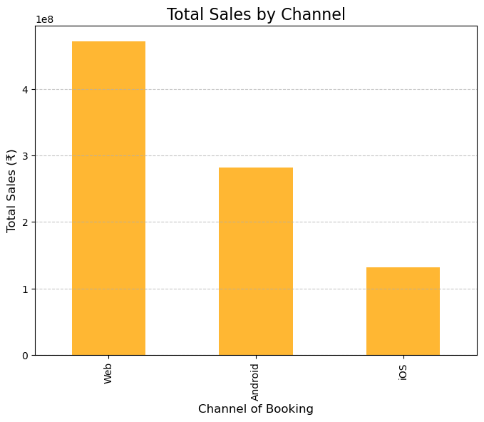
Channel Sales Contribution
A few booking channels contribute to most sales .
Web: 53.41% of bookings.
Android App: 31.68%.
iOS App: 14.91%.
Possible Causes
Uneven marketing investments across channels .
Customer preferences for certain platforms due to ease of use or trust .
Lack of promotional offers or visibility of underperforming channels .
Target audience mismatch between channels and buyers demographics .

Slide 6
Suggestion
Enhance Mobile App Experience:
Invest in improving the UI/UX of your mobile apps (both Android and iOS) to make them more user-friendly and efficient.
Example:
Implement app-only features, such as personalized recommendations, or instant notifications for deals.
Launch exclusive app-based discounts, e.g., a 10% discount for bookings made via the app during the first week of launch.
Run Targeted Campaigns for Underperforming Channels:
Identify the weaker channels (e.g., iOS with 14.91% contribution) and target them with tailored promotions.
Example:
Offer cashback or loyalty points for bookings via the iOS app.
Collaborate with Apple to advertise the app in the App Store or run campaigns targeting iOS users through Apple News or App Store ads.

Slide 7
Suggestion
Leverage Social Media for Web Channel Engagement:
Drive more users to the website by integrating social media advertising and influencer collaborations.
Example:
Run Google Ads and Facebook/Instagram campaigns that link directly to your website for bookings.
Partner with travel influencers to promote exclusive web-based offers, such as "Book through our website for up to 20% off your next flight."

Slide 8
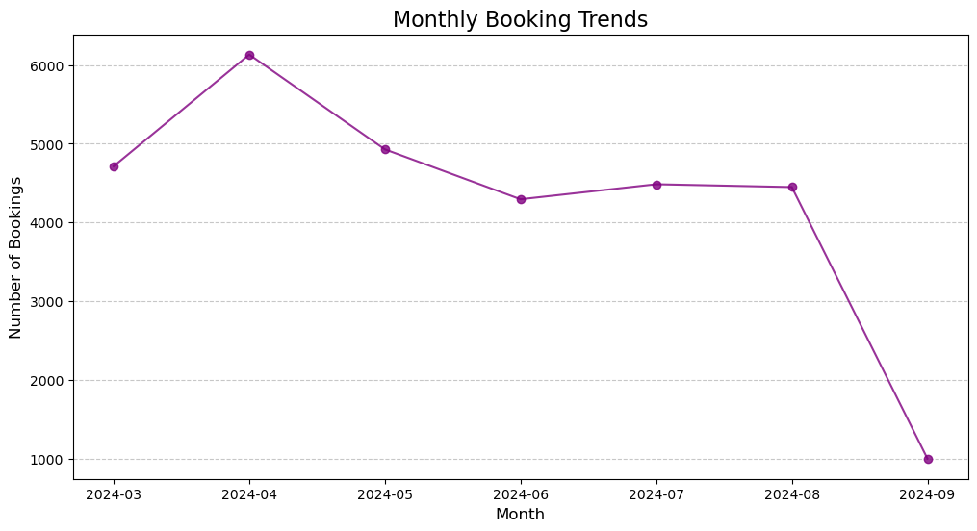
Monthly Booking Trends
Clear Peak and deep in monthly booking trends
Peaks observed in April (6,133 bookings), while March (4,713 bookings) and subsequent months like June (4,294 bookings) show lower activity, suggesting seasonal fluctuations.
Possible Causes
Seasonal Travel Behavior , such as holiday seasons or school vacations.
Weather conditions affecting travel preferences (eg. Monsoon season dips).
Major events like festivals, conferences, sports events driving demand.
Fluctuations in disposable income or economic factors influencing travel .

Slide 9
Suggestion
Offer Seasonal Discounts and Promotions:
Identify low-demand months (e.g., March and June based on your data) and introduce promotions to stimulate bookings during these periods.
Example:
"March Madness Sale: Get 15% off on all bookings made this month!"
Bundle discounts for off-season travel packages, such as hotel stays or car rentals.
Incentivize Early Bookings:
Encourage customers to book their tickets well in advance with discounted fares or added benefits.
Example:
"Book 3 months early and save up to 20% on your tickets."
Offer free upgrades (e.g., priority boarding) for bookings made during specific periods.

Slide 10
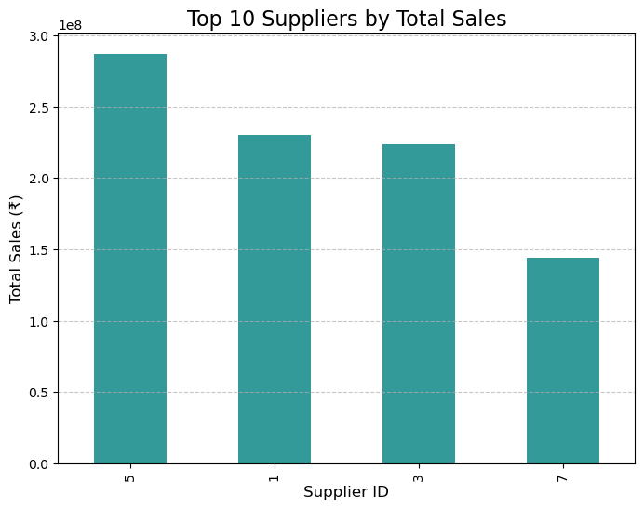
Supplier dependence
Heavy reliance on few suppliers for the majority of sales.
Majority of supplies got from id 5,1,3,7
Possible Causes
Preferential pricing or exclusive agreements with specific suppliers .
Limited availability of suppliers for certain routes or destinations
High reliability or trust in certain suppliers compared to others .
A smaller supplier base due to lack of partnership or onboarding efforts

Slide 11
Suggestion
Diversify the Supplier Base:
Reduce reliance on a few suppliers by onboarding additional vendors to ensure more options and bargaining power.
Example: If a supplier is providing 40% of the flights, aim to onboard 5–10 new suppliers for those routes to reduce dependency below 30%.
Implement Supplier Performance Monitoring:
Continuously evaluate suppliers on key metrics such as pricing consistency, reliability, and refund/complaint ratios. Use this data to identify and reduce dependency on underperforming suppliers.
Example: If a supplier has a high refund rate, allocate fewer bookings to them and prioritize others with a better track record.

Slide 12
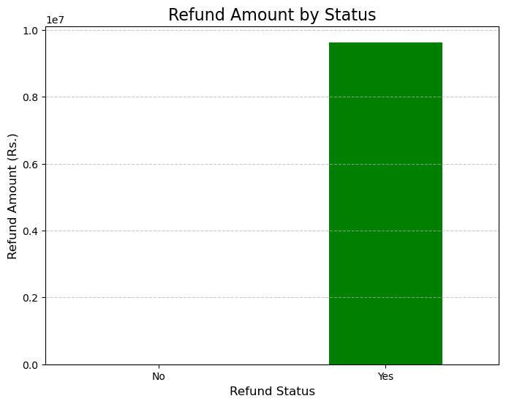
Refund patterns
High refunds in specific transactions and buyers category .
Refund Status: 23,512 bookings (78.37%) resulted in refunds, with an average refund amount of ₹409.50.Non-Refunded Bookings: 6,488 bookings (21.63%) had no refunds
Possible Causes
Unreliable suppliers or operational issues causing flight cancellation.
Frequent Cancellation or modification by buyers to exploit refund policies for financial gains
Errors in booking details (incorrect travel dates, passenger names etc.)

Slide 13
Suggestion
Clear Communication: Ensure customers fully understand refund policies before booking.
Flexible Options: Offer rescheduling or vouchers instead of strict refunds.
Customer Retention: Implement loyalty programs to discourage frequent cancellations.
Regularly analyze refund requests to identify top causes and address them with targeted strategies . Gather post-refund feedback to understand customer dissatisfaction.
Offer a price lock option for a nominal fee to help customers finalize plans without committing immediately. Highlight cancellation terms upfront during the booking process.
Example: A customer books a flight but later realizes they need to reschedule due to a family emergency. They cancel the ticket and request a refund. Solution:
Offer free or discounted rescheduling options instead of full refunds.
Provide travel insurance add-ons at the time of booking to cover unforeseen cancellations.

Slide 14
Thank You
Harshit Garg
12111017
hgarg4145@gmail.com
7082227187

